Slide 1
Game Devevloper
TOBY FOX
By Thomas

Slide 2
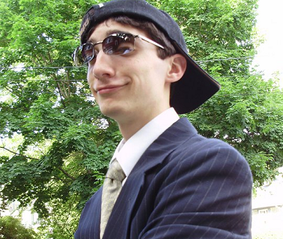
About Toby Fox
American video game developer and composer
Born in Boston, Massachusetts, U.S.A. on October 11th, 1991 (age 26)
Best known for making the critically acclaimed video game UNDERTALE for PC and Mac on Sept. 15th, 2015
Also well known for making a Halloween ROM hack for the video game Earthbound and composing various songs for the infamous webcomic Homestuck

Slide 3
What is UNDERTALE?

Slide 4
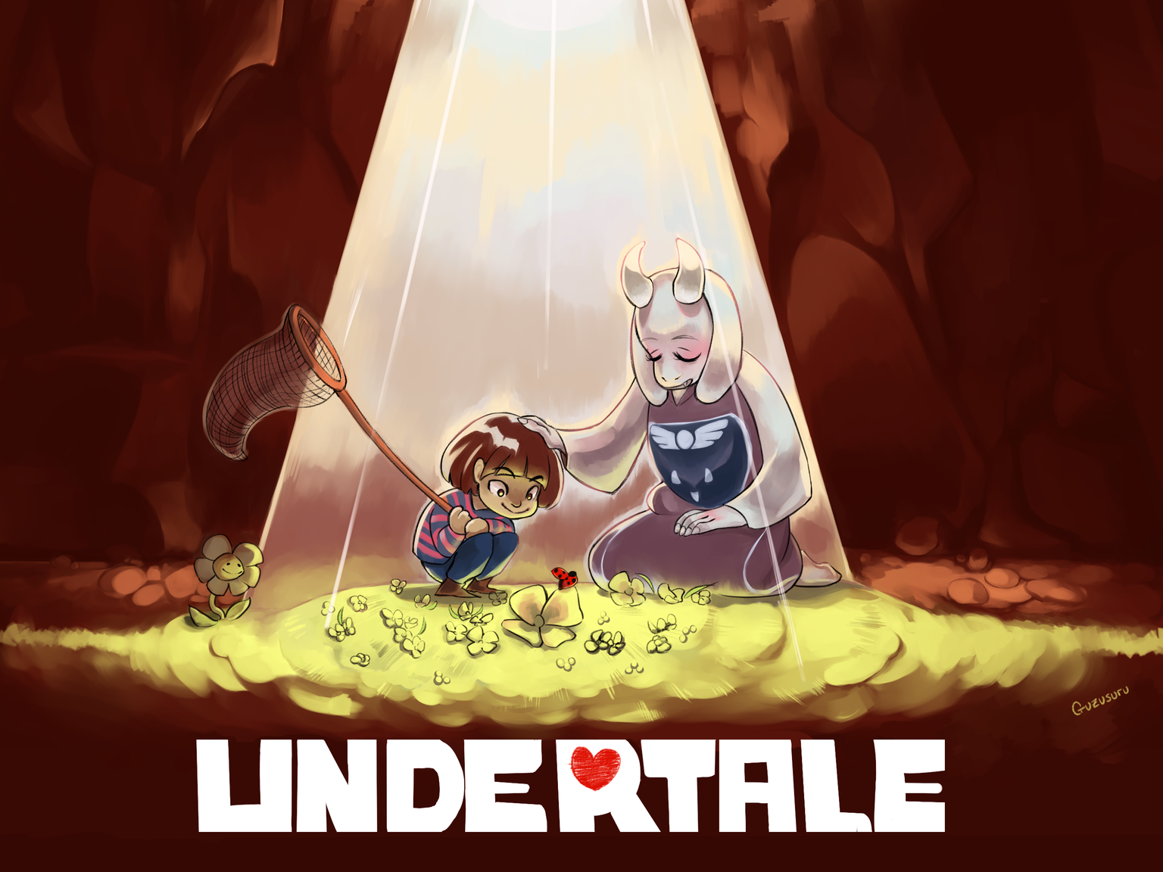
UNDERTALE is a role-playing video game where players control a human child who has fallen into the Underground.
The player meets various monsters on their quest to return to the surface.
When you encounter a monster in battle, you can choose to offer mercy and spare these monsters instead of killing them.
These choices will affect the entire game.

Slide 5
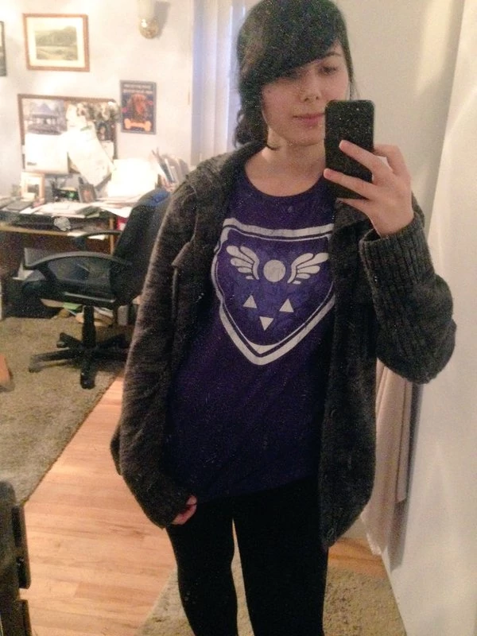
DEVELOPMENT
UNDERTALE was developed by Toby Fox for approximately 2.7 years.
He developed the entire game independently, with some assistance from Temmie Chang.
Development was financed through a campaign on Kickstarter on June 25th, 2013 with a goal of US$5,000 and ended with a grand total of US$51,124.
Toby wanted to work on UNDERTALE independently to avoid relying on others.
The game’s art style would likely remain the same if Toby had access to a larger team of artists.
Temmie Chang
HOI!

Slide 6
GAME DESIGN
When working on the battle system, Toby Fox wanted to create a mechanic that he would personally enjoy.
He did not want grinding to be necessary, instead leaving it optional to players.
He also did not wish to introduce side quests and that he dislikes the idea.
Toby Fox ensures that the difficulty of the game is easy and enjoyable.
He asked some friends who were inexperienced to test the game and found that they were able to complete it.
Don’t you have anything better to do?

Slide 7
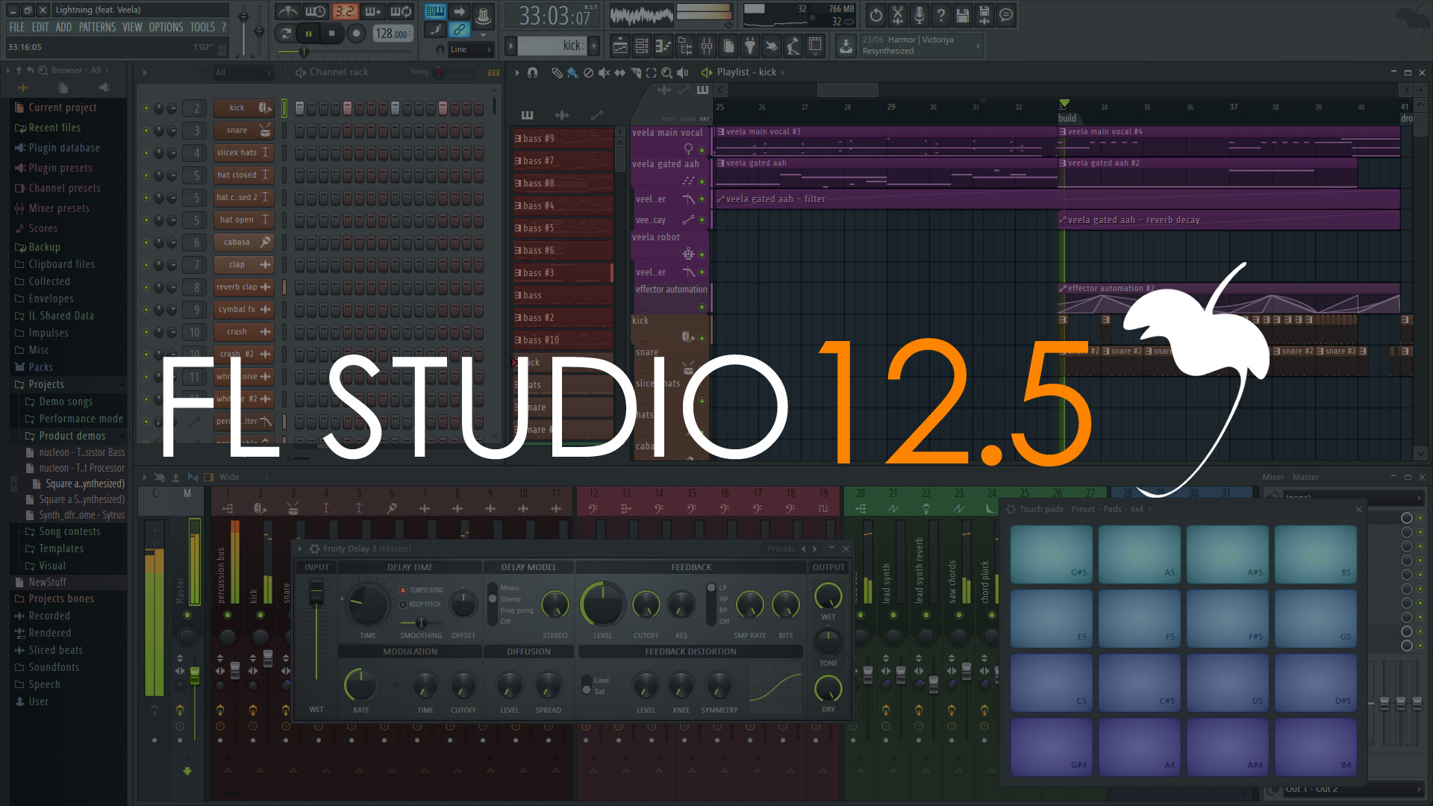
MUSIC
Toby Fox composed the entire game’s soundtrack.
He’s a self-taught musician who plays piano/keyboard.
For each section of the game, Toby composed the music prior to programming, as it helped "decide how the scene should go".
The soundtrack has been well received by critics for its use of various leitmotifs for the various characters used throughout various tracks.
https://www.youtube.com/watch?v=s7RRgF5Ve_E
https://www.youtube.com/watch?v=zdeZwAk6ULE
https://www.youtube.com/watch?v=41YOknSl0zw

Slide 8
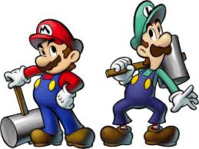
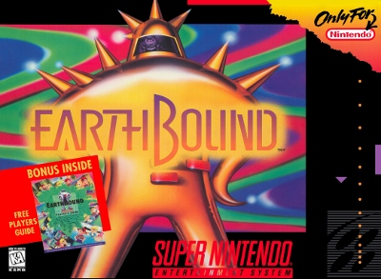
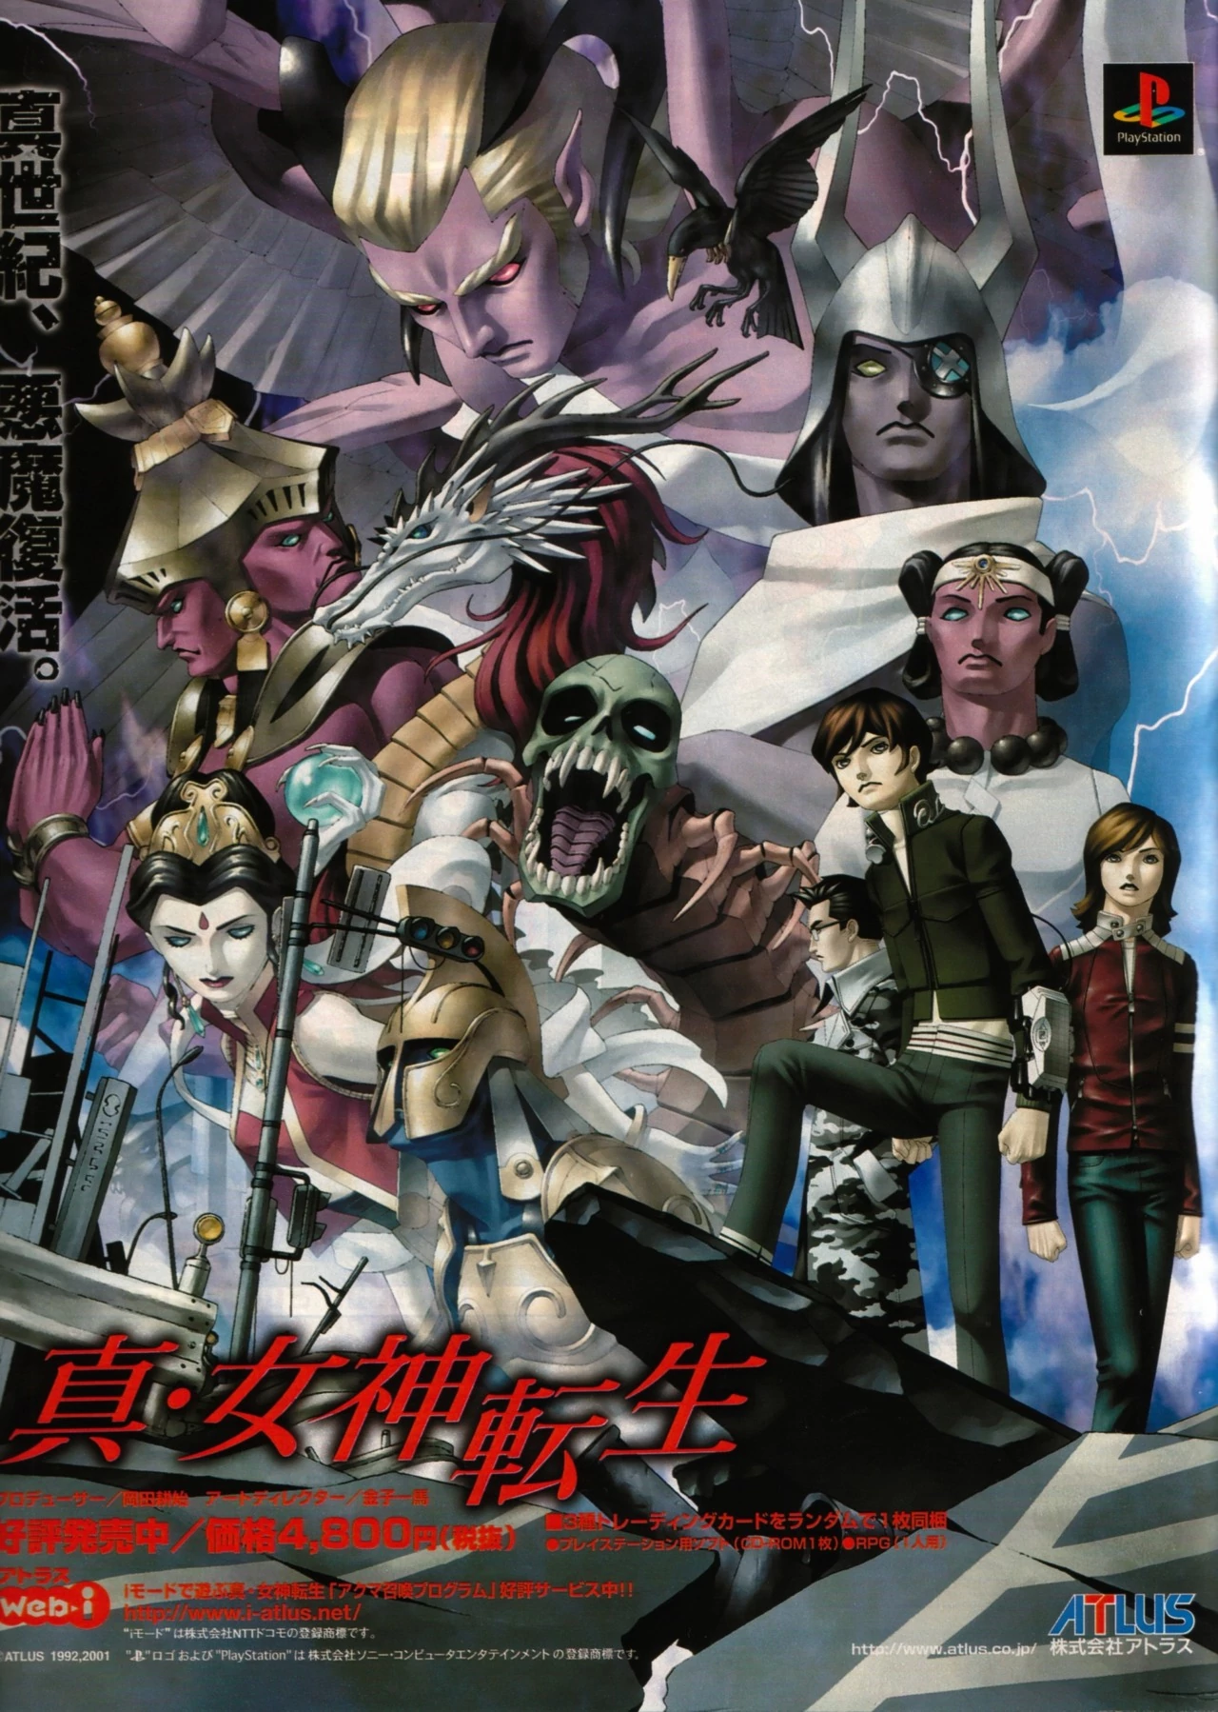
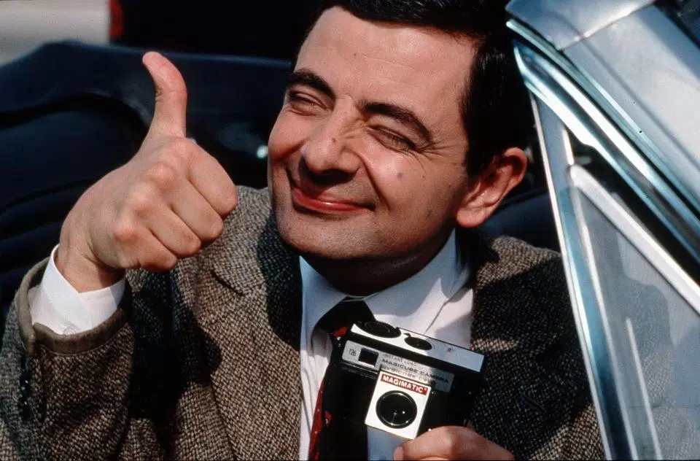
INFLUENCES
The defensive segment in combat was inspired by the Mario & Luigi series and bullet hell shooters such as the Touhou Project series.
The game’s dialogue system was inspired by the Shin Megami Tensei series.
The game’s writing was partly influenced by the silliness of internet culture, as well as comedy shows like Mr. Bean.
He was also inspired by the unsettling atmosphere of Earthbound.

Slide 9
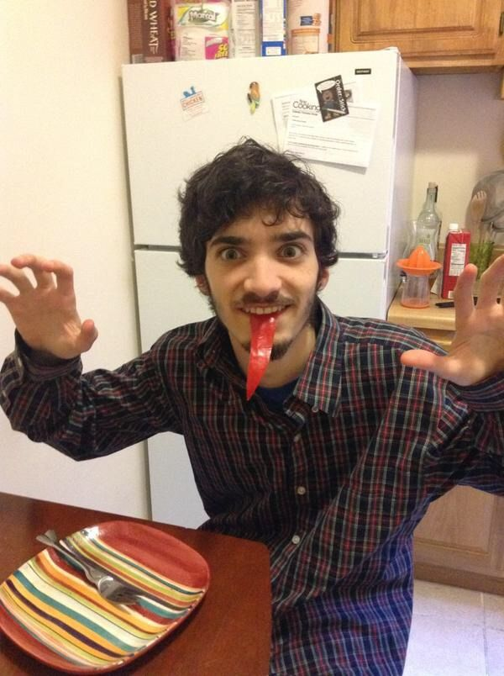
RECEPTION
UNDERTALE was critically acclaimed for its writing, thematic material, intuitive combat system, musical score and originality, with praise directed towards its story, dialogue and characters.
The game has sold over 3 million copies, and was nominated for multiple accolades and awards, including “Game of the Year” from several gaming publications and conventions.
Toby was surprised by how popular UNDERTALE had become and although he was appreciative of the attention, he became stressed out over it.

Slide 10
QUIZ
How many dogs are in this presentation?
2
3
4
5
3. How long was
UNDERTALE in
development?
3 years
2.5 years
2 years
2.7 years
5. Who was the
main artistic
assistant
for UNDERTALE?
2. How old is
Toby Fox?
22
26
28
24
4. What instrument
does Toby Fox
play?
Piano/Keyboard
Guitar
Trumpet
Drums

